Slide 2
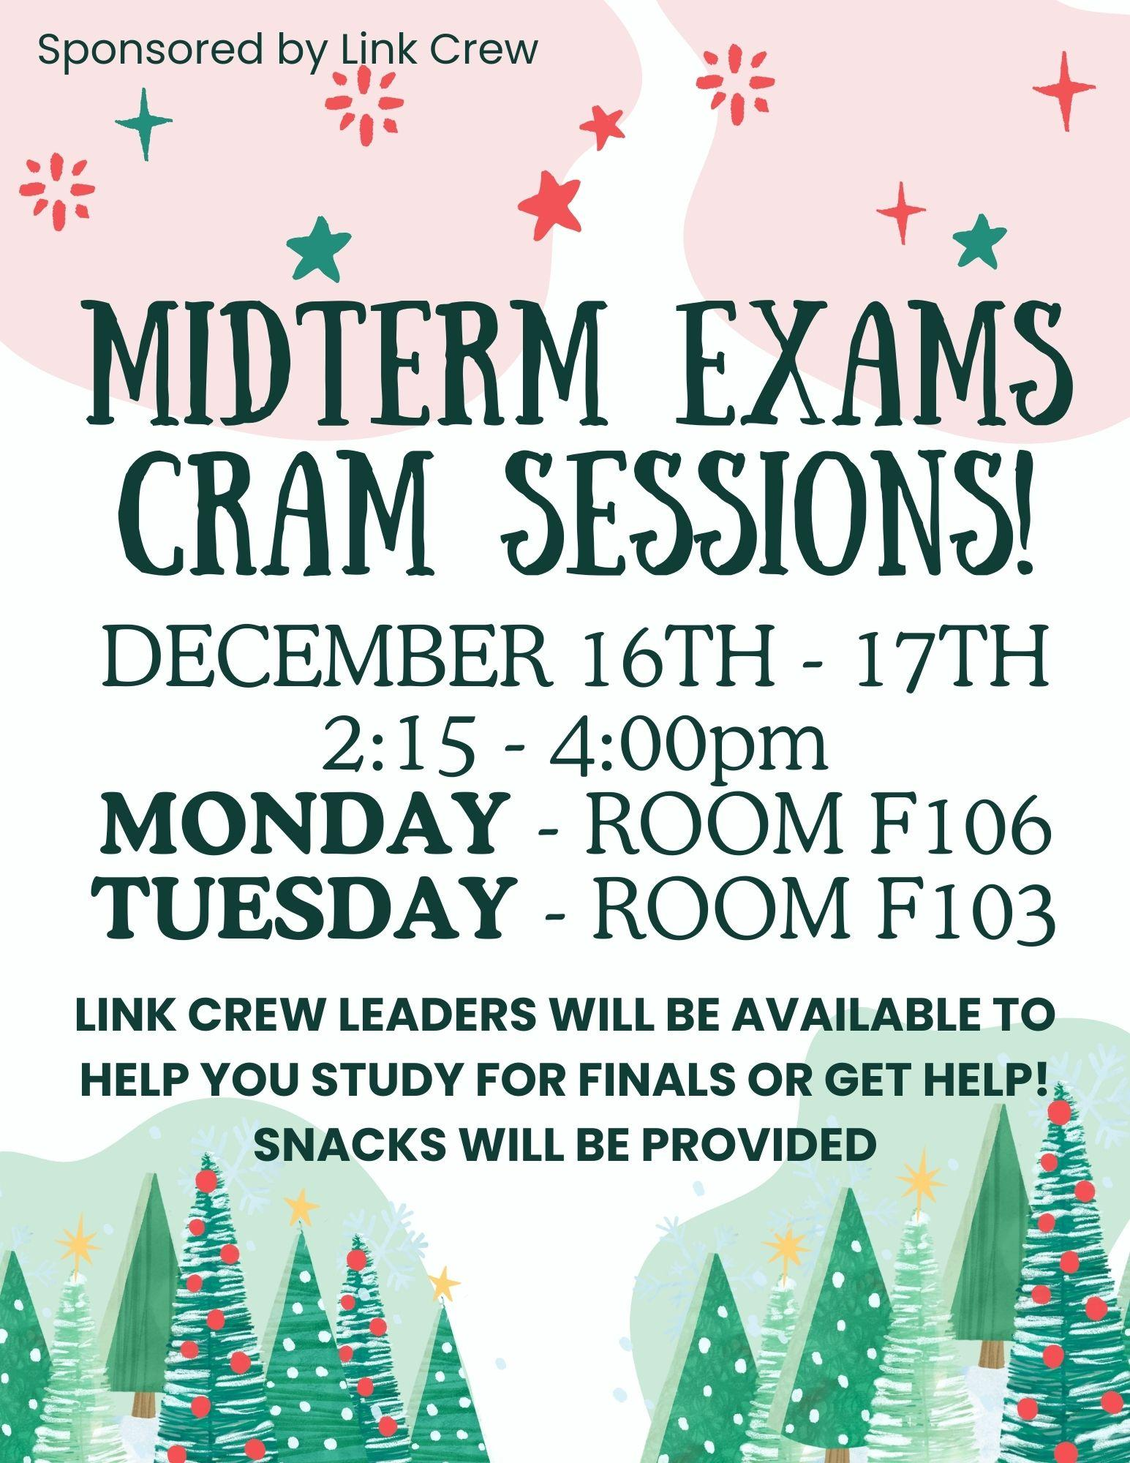

Slide 3
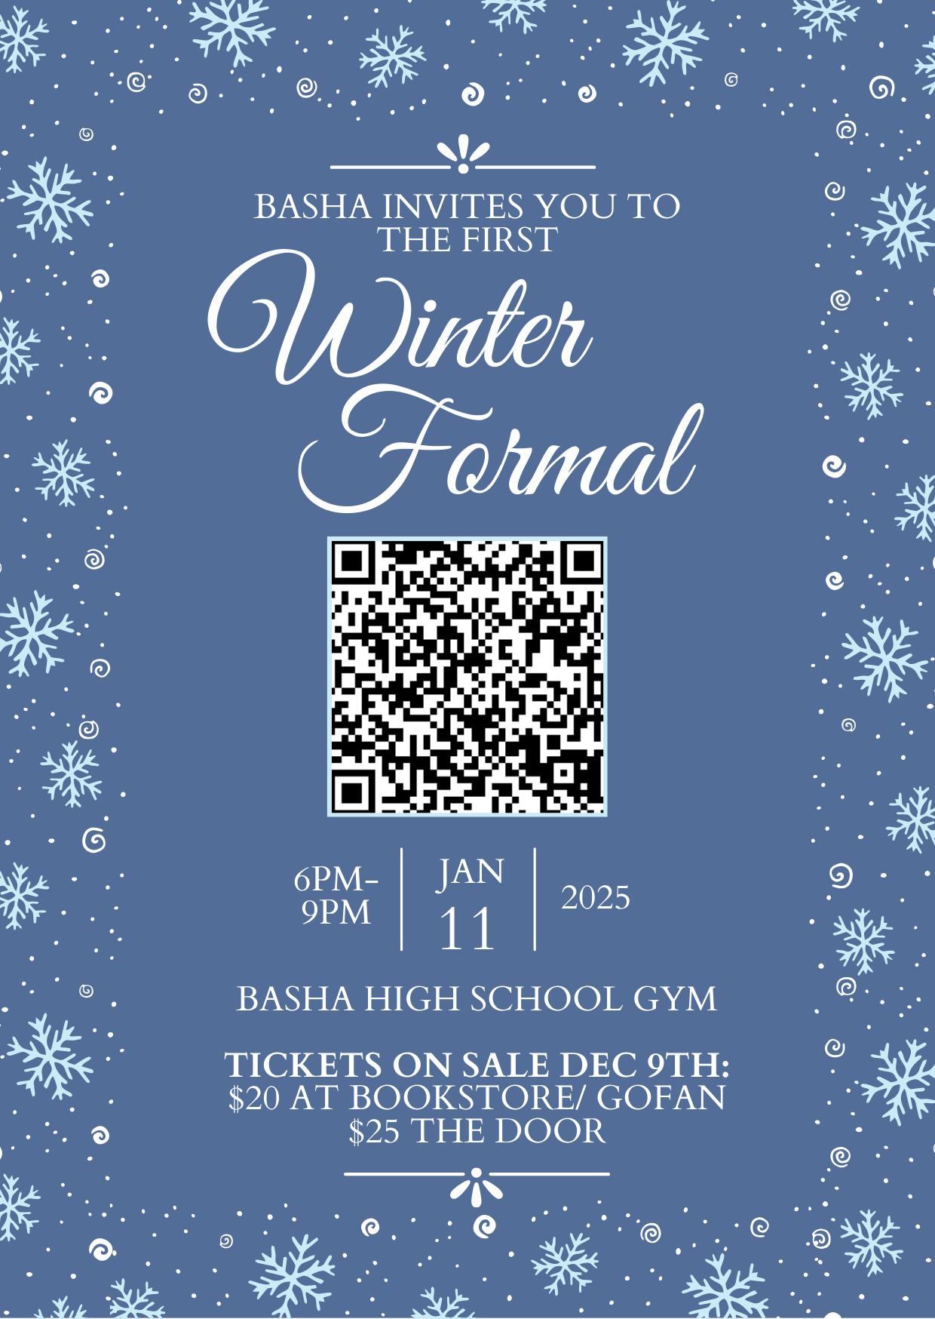

Slide 5
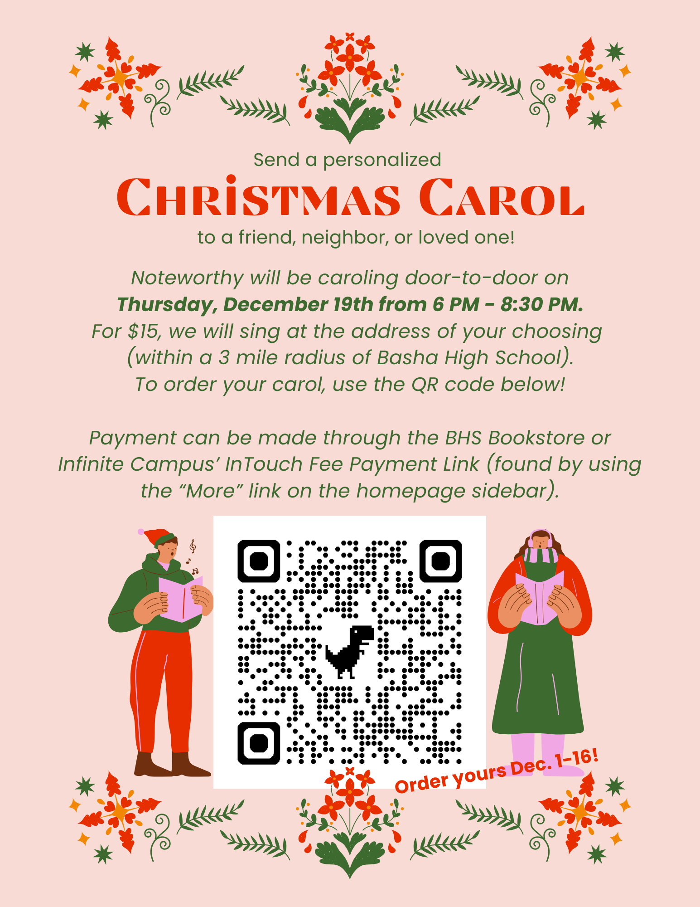

Slide 11
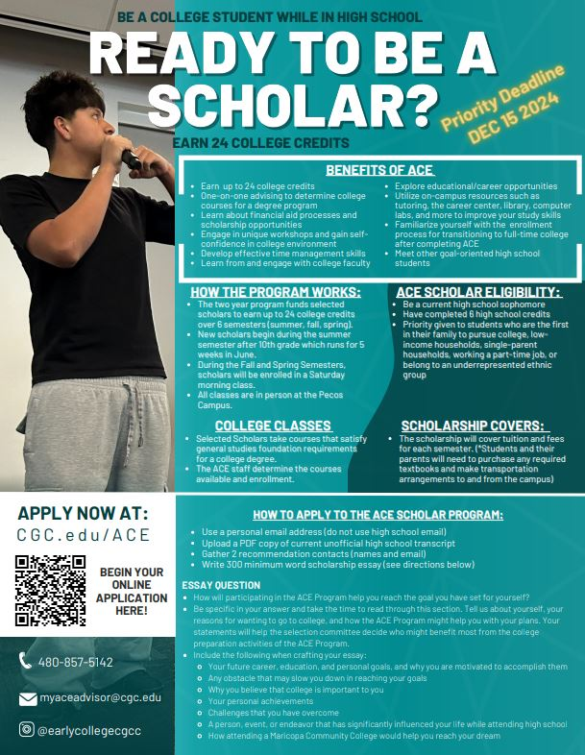

Slide 15
BASHA HIGH
does not accept food deliveries or food drop offs.
Thank you!

Slide 16
Basha High dress code.
Brief and revealing clothing, clothing with messages that are vulgar, offensive, obscene, or demeaning to others are not appropriate apparel.
Students wearing such items will be dress coded. If you have questions about the dress code, please refer to BHS Handbook.

Slide 17
New Library rules for the new year!
No FOOD or DRINK.
No rough play.
No inappropriate language.
Water is acceptable.
Please keep the library clean.
Stay awesome and respect the space!

Slide 18
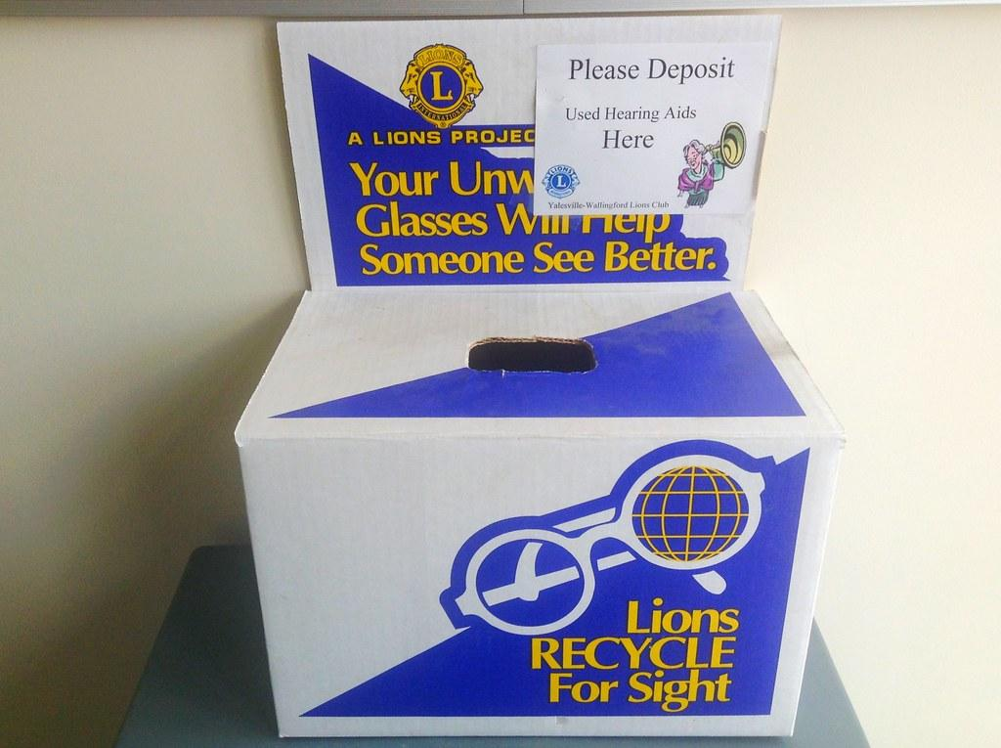
Your unwanted glasses will help someone see better!
Donate Today! Box is at Kalli’s desk in the front office.

